Slide 1
CSE115
Lecture 3 & 4
Dr. Mohammad Abu Yousuf (MAY)

Slide 2
Constants
Constants
Numeric
Constants
Character
Constants
integer
floating-point
single
character
string

Slide 3
Integer Constants
Consists of a sequence of digits, with possibly a plus or a minus sign before it.
Embedded spaces, commas and non-digit characters are not permitted between digits.
Maximum and minimum values (for 32-bit representations)
Maximum :: 2147483647
Minimum :: – 2147483648

Slide 4
Floating-point Constants
Can contain fractional parts.
Very large or very small numbers can be represented.
23000000 can be represented as 2.3e7
Two different notations:
Decimal notation
25.0, 0.0034, .84, -2.234
Exponential (scientific) notation
3.45e23, 0.123e-12, 123E2
e means “10 to the power of”

Slide 5
Single Character Constants
Contains a single character enclosed within a pair of single quote marks.
Examples :: ‘2’, ‘+’, ‘Z’
Some special backslash characters
‘\n’ new line
‘\t’ horizontal tab
‘\’’ single quote
‘\”’ double quote
‘\\’ backslash
‘\0’ null

Slide 6
String Constants
Sequence of characters enclosed in double quotes.
The characters may be letters, numbers, special characters and blank spaces.
Examples:
“nice”, “Good Morning”, “3+6”, “3”, “C”

Slide 7
Escape Sequences
There are certain characters in C when they are preceded by a backslash they will have special meaning.
Sequence Meaning
\a Bell (alert)
\b Backspace
\n Newline
\t Horizontal tab
\\ Backslash
\' Single quote
\" Double quotation
\xhh ASCII char specified by hex digits hh
\ooo ASCII char specified by octal digits ooo

Slide 8
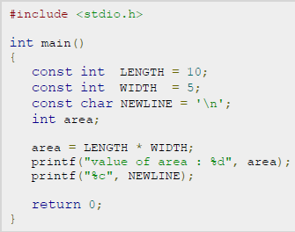
Example: Constant (The const keyword)
Syntax: const type variable = value;

Slide 9
Declaration of Variables
There are two purposes:
It tells the compiler what the variable name is.
It specifies what type of data the variable will hold.
Syntax:
data-type variable_1, variable_2,……..,variable_n;
Examples:
int velocity, distance;
int a, b, c, d;
float temp;
char flag, option;

Slide 10
An Example : Variable Declaration
#include <stdio.h>
main()
{
float speed, time, distance;
scanf (“%f %f”, &speed, &time);
distance = speed * time;
printf (“\n The distance traversed is: \n”, distance);
}
Variable declaration

Slide 11
Expression
An expression represents a single data item, such as a number or a character. The expression may consist of a single entity, such as a constant, a variable, an array element or a reference to a function. It may also consist of some combination of such entities, interconnected by one or more operators.
Several simple expressions are shown below.
a + b
x = y
c = a + b
x <= y
x == Y
++i

Slide 12
Statement
A statement causes the computer to carry out some action. There are three different classes of statements in C.
They are expression statements, compound statements and control statements.
Expression Statement:
An expression statement consists of an expression followed by a semicolon.
a = 3; // Assignment statement
c = a + b ; // Assignment statement
++i; // Incremental statement
p r i n t f ("Area = %f area) ;

Slide 13
Statement (Cont..)
Compound Statement:
A compound statement consists of several individual statements enclosed within a pair of braces { }.
A typical compound statement is shown below.
{
p i = 3.141593;
circumference = 2. * p i * radius;
area = p i * radius * radius;
}

Slide 14
Statement (Cont..)
Control Statement:
Control statements are used to create special program features, such as logical tests, loops and branches.
Example:
while (count <= n) {
p r i n t f ( ' x = ' ) ;
scanf ( “%f" , &x) ;
sum += x;
++count;
}

Slide 15
Operator and Expression
Operators
Arithmetic
Operators
Relational
Operators
Logical
Operators

Slide 16
Arithmetic Operators
Addition :: +
Subtraction :: –
Division :: /
Multiplication :: *
Modulus :: %
Examples:
distance = rate * time ;
netIncome = income - tax ;
speed = distance / time ;
area = PI * radius * radius;
y = a * x * x + b*x + c;
quotient = dividend / divisor;
remain =dividend % divisor;

Slide 17
Arithmetic Operators(Cont..)
Suppose x and y are two integer variables, whose values are 13 and 5 respectively.
x + y | 18
x – y | 8
x * y | 65
x / y | 2
x % y | 3

Slide 18
Operator Precedence
In decreasing order of priority
Parentheses :: ( )
Unary minus :: –5
Multiplication, Division, and Modulus
Addition and Subtraction
For operators of the same priority, evaluation is from left to right as they appear.
Parenthesis may be used to change the precedence of operator evaluation.

Slide 19
Examples: Arithmetic expressions
a + b * c – d / e ➔ a + (b * c) – (d / e)
a * – b + d % e – f ➔ a * (– b) + (d % e) – f
a – b + c + d ➔ (((a – b) + c) + d)
x * y * z ➔ ((x * y) * z)
a + b + c * d * e ➔ (a + b) + ((c * d) * e)

Slide 20
Type Cast
The value of an expression can be converted to a different data type if desired.
To do so, the expression must be preceded by the name of the desired data type, enclosed in parentheses, i.e.,
(data type) expression.
Example:
int x=10;
float y,z=3.14;
y=(float) x; /* y=10.0 */
x=(int) z; /* x=3 */
x=(int) (-z); /* x=-3 -- rounded approaching zero */

Slide 21
Relational Operators
Used to compare two quantities.
< is less than
> is greater than
<= is less than or equal to
>= is greater than or equal to
== is equal to
!= is not equal to

Slide 22
Relational Operators: Examples
10 > 20 is false
25 < 35.5 is true
12 > (7 + 5) is false
When arithmetic expressions are used on either side of a relational operator, the arithmetic expressions will be evaluated first and then the results compared.
a + b > c – d is the same as (a+b) > (c+d)

Slide 23
Relational Operators: Examples
Sample code segment in C
if (x > y)
printf (“%d is larger\n”, x);
else
printf (“%d is larger\n”, y);

Slide 24
Logical Operators
There are two logical operators in C (also called logical connectives).
&& ➔ Logical AND
| | ➔ Logical OR
What they do?
They act upon operands that are themselves logical expressions.
The individual logical expressions get combined into more complex conditions that are true or false.

Slide 25
Logical Operators (Cont..)
Logical AND
Result is true if both the operands are true.
Logical OR
Result is true if at least one of the operands are true.
X | Y | X && Y | X | | Y
FALSE | FALSE | FALSE | FALSE
FALSE | TRUE | FALSE | TRUE
TRUE | FALSE | FALSE | TRUE
TRUE | TRUE | TRUE | TRUE

Slide 26
Other Operators
Some unary operators: -, ++, --, !
Example : ++a, --b
C contains the following five additional assignment operators: +=, -= , *=, /= and %=.
To see how they are used, consider the first operator, +=. The assignment expression
expression 1 += expression 2
is equivalent to
expression 1 = expression 1 + expression 2
Similarly, the assignment expression
expression I -= expression 2
is equivalent to
expression 1 = expression I - expression 2
and so on for all five operators.

Slide 27
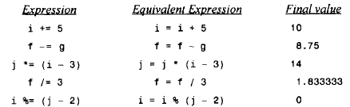
Other Operators
Suppose that i and j are integer variables whose values are 5 and 7, and f and g are floating-point variables whose values are 5.5 and -3.25.

Slide 28
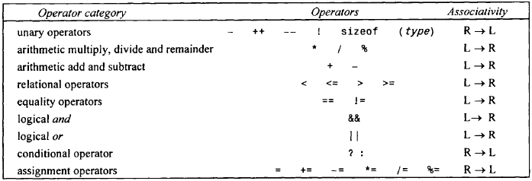
Operator Precedence Groups

Slide 29
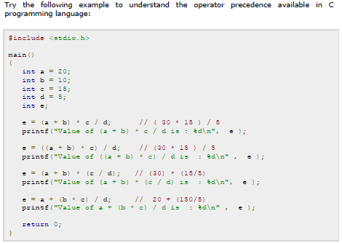
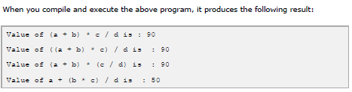

Slide 30
Library function
The C language is accompanied by a number of library functions that carry out various commonly used operations or calculations.
A library function is accessed simply by writing the function name, followed by a list of arguments that represent information being passed to the function.

Slide 31
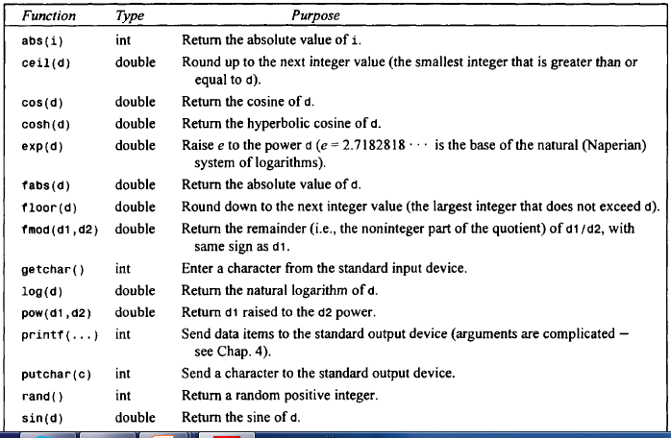
Library function (Cont..)
Some commonly used library function

Slide 32
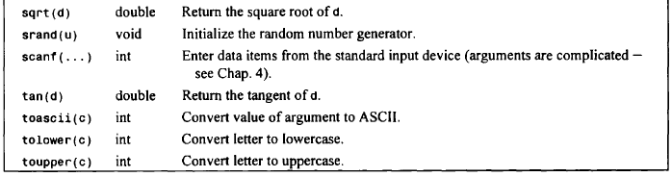
Library function (Cont..)

Slide 33
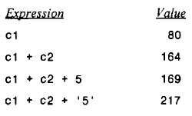
suppose that c1 and c2 are character-type variables that represent the characters P and T, respectively. Several arithmetic expressions that make use of these variables are shown below, together with their resulting values (based upon the ASCII character set).
Note that P is encoded as (decimal) 80, T is encoded as 84, and 5 is encoded as 53 in the ASCII character set

